Slide 1
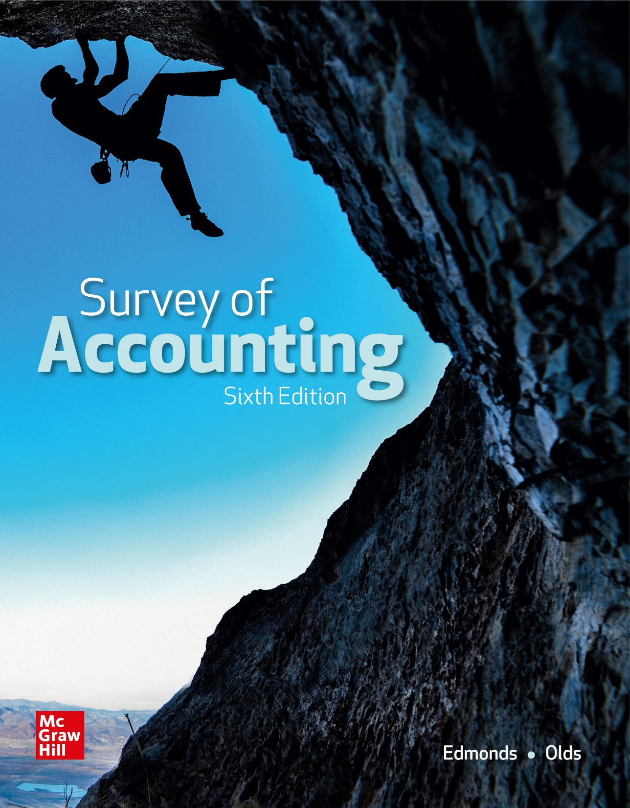
Chapter 14
Planning for Profit and Cost Control

Slide 2
LO 14-1:
Describe the budgeting process and the benefits it provides.

Slide 3
The Planning Process
Planning normally addresses three different time horizons:
Short term planning focuses on the coming year.
Intermediate-range planning usually covers three to five years.
Long-range planning focuses on time frames more than 5 years in the future.

Slide 4
Three Levels of Planning
Strategic planning involves making long-term decisions such as defining the scope of the business, determining which products to develop or discontinue, and identifying the most profitable markets.
Capital budgeting focuses on intermediate-range planning and involves decisions such as whether to buy or lease equipment, whether to stimulate sales, or whether to increase company asset base.
Operations budgeting concentrates on short-term plans. A key component is the master budget.

Slide 5
Advantages of Budgeting
Planning
The budget formalizes and documents managerial plans.
Coordination
The budgeting process forces coordination among departments to promote decisions in the best interest of the company as a whole.

Slide 6
Advantages of Budgeting
Performance Measurement
Comparing actual results to budget expectations provides a way to evaluate performance.
Corrective Action
Budgeting provides advance notices of potential shortages, bottlenecks, or other weaknesses in operating plans.

Slide 7
Budgeting and Human Behavior
Upper management must be sensitive to the impact of the budgeting process on employees.
Budgets are constraining. They limit individual freedom in favor of an established plan.
Many people find evaluation based on budget expectations stressful.
Upper management must demonstrate that budgets are sincere efforts to express realistic goals employees are expected to meet.

Slide 8
The Master Budget
The master budget is a group of detailed budgets and schedules representing the company’s operating and financial plans, and normally includes
Operating budgets
Capital budgets
Pro forma financial statements

Slide 9
Hampton Hams Budgeting Illustration
The budgeting process normally begins with preparing the operating budgets.
Hampton Hams uses
A sales budget
An inventory purchases budget
A selling and administrative (S&A) expense budget
A cash budget

Slide 10
Information Flows in the Master Budget

Slide 11
LO 14-2:
Prepare a sales budget and related schedule of cash receipts.

Slide 12
Sales Budget
Preparing the master budget begins with the sales forecast.
Its accuracy is critical because all the other budgets are derived from it.
The marketing department coordinates the development of the sales forecast.
Sales estimates frequently flow from the bottom up to the higher management levels.

Slide 13
Sales Budget Example
To develop the sales forecast for Hampton Ham’s (HH’s) new store, the sales manager studied the sales history of similar existing stores.
The new store’s sales are expected to be $160,000 in October ($40,000 in cash and $120,000 on account).
Sales are expected to increase 20 percent per month during November and December.
The sales manager prepared the sales budget in exhibit 14-2

Slide 14
Sales Budget for Hampton Hams

Slide 15
Sales Budget: Projected Sales Section
The projected sales section of the sales budget shows the projected total sales for each month (cash sales and sales on account).
The sales forecast reflects a 20 percent increase over the previous month’s cash sales and sales on account.
November cash sales are calculated as
[$40,000 + ($40,000 x 0.20)] = $48,000

Slide 16
Sales Budget: Projected Sales Section
The remaining projections for the sales budget are calculated as follows
December cash sales are calculated as
[$48,000 + ($48,000 x 0.20)] = $57,600
November sales on account are calculated as
[$120,000 + ($120,000 x 0.20)] = $144,000
December sales on account are calculated as
[$144,000 + ($144,000 x 0.20)] = $172,800

Slide 17
Sales Budget: Schedule of Cash Receipts
This schedule is used later to prepare the cash budget.
Hampton Hams (HH) will collect cash sales in the month of sale.
HH assumes it will collect accounts receivable from credit sales in full in the month following the sale.
For example, October credit sales will be collected in full in November.
Collections may spread over several months, and some receivables may never be collected.

Slide 18
Total Cash Receipts
Total cash receipts are determined by adding the current month’s cash sales to the cash collected from the previous month’s credit sales (accounts receivable balance).
October receipts are projected to be $40,000 because the store opens in October.
November receipts are projected to be $168,000 ($48,000 November cash sales + $120,000 October sales on account).
December receipts are projected to be $201,600 ($57,600 December cash sales + $144,000 November sales on account).

Slide 19
Sales Budget: Schedule of Cash Receipts

Slide 20
Pro Forma Financial Statement Data
The Pro Forma Data column in the sales budget displays two figures reported on the quarter-end (December 31) budgeted financial statements.
The accounts receivable balance will be reported on the balance sheet as $172,800 (December credit sales).
The $582,400 of sales revenue will be reported on the budgeted income statement for the quarter.
This amount is the total sales revenue ($160,000 + $192,000 + $230,400)

Slide 21
LO 14-3:
Prepare an inventory purchases budget and related schedule of cash payments.

Slide 22
Inventory Purchases Budget
The Inventory purchases budget shows the amount of inventory HH must purchase each month to satisfy the demand projected in the sales budget.
The total inventory needed each month equals the amount of inventory HH plans to sell that month plus the amount of inventory HH wants on hand at month-end.
To the extent that total inventory needed exceeds the inventory on hand, HH will need to purchase additional inventory.

Slide 23
Inventory Purchases Budget
The amount of inventory to purchase is computed as follows:

Slide 24
Inventory Purchases Budget Example
It is HH’s policy to maintain an ending inventory equal to 25 percent of the next month’s projected cost of goods sold.
HH’s cost of goods sold normally equals 70 percent of sales.
The inventory purchases budget shown in Exhibit 14.3 was prepared using this information and the information in the sales budget.

Slide 25
Inventory Purchases Budget Example
The ending inventory in one month becomes the beginning inventory in the following month.
For example, October’s desired ending inventory becomes November’s beginning inventory.

Slide 26
Inventory Purchases Budget
HH determined budgeted cost of goods sold for October by multiplying October budgeted sales by 70 percent ($160,000 x 0.70 = $112,000).
The October desired ending inventory was computed by multiplying November budgeted cost of goods sold by 25 percent ($134,400 x 0.25 = $33,600).
Desired ending inventory for November is $40,320 ($161,280 x 0.25).
Desired ending inventory for December is based on January projected cost of goods sold of $140,000.

Slide 27
Schedule of Cash Payments for Inventory Purchases
Cash payments are projected as follows:
October cash payments for inventory are $87,360. Because the store opens in October, no accounts payable balance from September remains to be paid in October.
November cash payments for inventory are $142,912 (40 percent of October purchases + 60 percent of November purchases).
December cash payments for inventory are $150,024 (40 percent of November purchases + 60 percent of December purchases).

Slide 28
Inventory Purchases Budget Example
$145,600 x 60% = $87,360
$145,600 x 40% = $58,240

Slide 29
Pro Forma Financial Statement Data
The Pro Forma Data column displays three figures HH will report on the quarter-end budgeted financial statements.
The $407,680 cost of goods sold is reported on the pro forma income statement.
The $35,000 ending inventory as of December 31 is reported on the pro forma balance sheet.
The $682,384 of accounts payable is reported on the pro forma balance sheet.

Slide 30
LO 14-4:
Prepare a selling and administrative expense budget and related schedule of cash payments.

Slide 31
Selling and Administrative Expense Budget
The details of the Selling and Administrative (S&A) Budget shown on the following slides:
Sales commission (based on 2% of sales) is paid in the month following the sale.
Supplies expense (based on 1% of sales) is paid in the month of the sale.
The utility expense is paid in the month following the usage of the electricity, gas, and water.

Slide 32
Selling and Administrative Expense Budget

Slide 33
Selling and Administrative Expense Budget

Slide 34
LO 14-5:
Prepare a cash budget.

Slide 35
Cash Receipts Section
The total cash available is determined by adding the beginning cash balance to the cash receipts from customers.
Cash receipts from customers come from the schedule of cash receipts in the sales budget.

Slide 36
Cash Payments Section
Cash payments include expected cash outflows for inventory purchases, S&A expenses, interest expense, and investments.
The cash payments for inventory purchases come from the schedule of cash payments for inventory purchases.
The cash payments for S&A expenses come from the schedule of cash payments for S&A expenses.

Slide 37
Cash Payments and Financing
HH plans to purchase, for cash, store fixtures with a cost of $130,000 in October.
HH borrows or repays principal and interest on the last day of each month. Any money borrowed from the bank bears interest at an annual rate of 12% (1% per month).
The management at HH wants to maintain a cash balance of at least $10,000 at the end of every month.

Slide 38
Cash Budget for Hampton Hams

Slide 39
Cash Budget Data for Hampton Hams

Slide 40
LO 14-6:
Prepare a pro forma income statement, balance sheet, and statement of cash flows.

Slide 41
Pro Forma Income Statement
The pro forma income statement gives management an estimate of the expected profitability of HH.
If the project appears to be unprofitable, management can make the decision to abandon it.
Although managers remain responsible for data analysis and decision making, computer technology offers powerful tools to assist in those tasks.

Slide 42
Pro Forma Income Statement for Hampton Hams

Slide 43
Pro Forma Balance Sheet
Most of the figures on the pro forma balance sheet have already been explained.
The new store has no contributed capital because its operations will be financed through debt and retained earnings.
The amount of retained earnings equals the amount of net income because no earnings from prior periods exist and no distributions are planned.

Slide 44
Pro Forma Balance Sheet for Hampton Hams

Slide 45
Pro Forma Statement of Cash Flows

Slide 46
Budgeting
The planning of financial matters is called budgeting.
Strategic planning involves long-term plans, such as the overall objectives of the business.
Strategic plans are stated in broad, descriptive terms.
Capital budgeting deals with intermediate investment planning.
Operations budgeting focuses on short-term plans and is used to create the master budget.

Slide 47
End of Chapter 14

